Slide 1
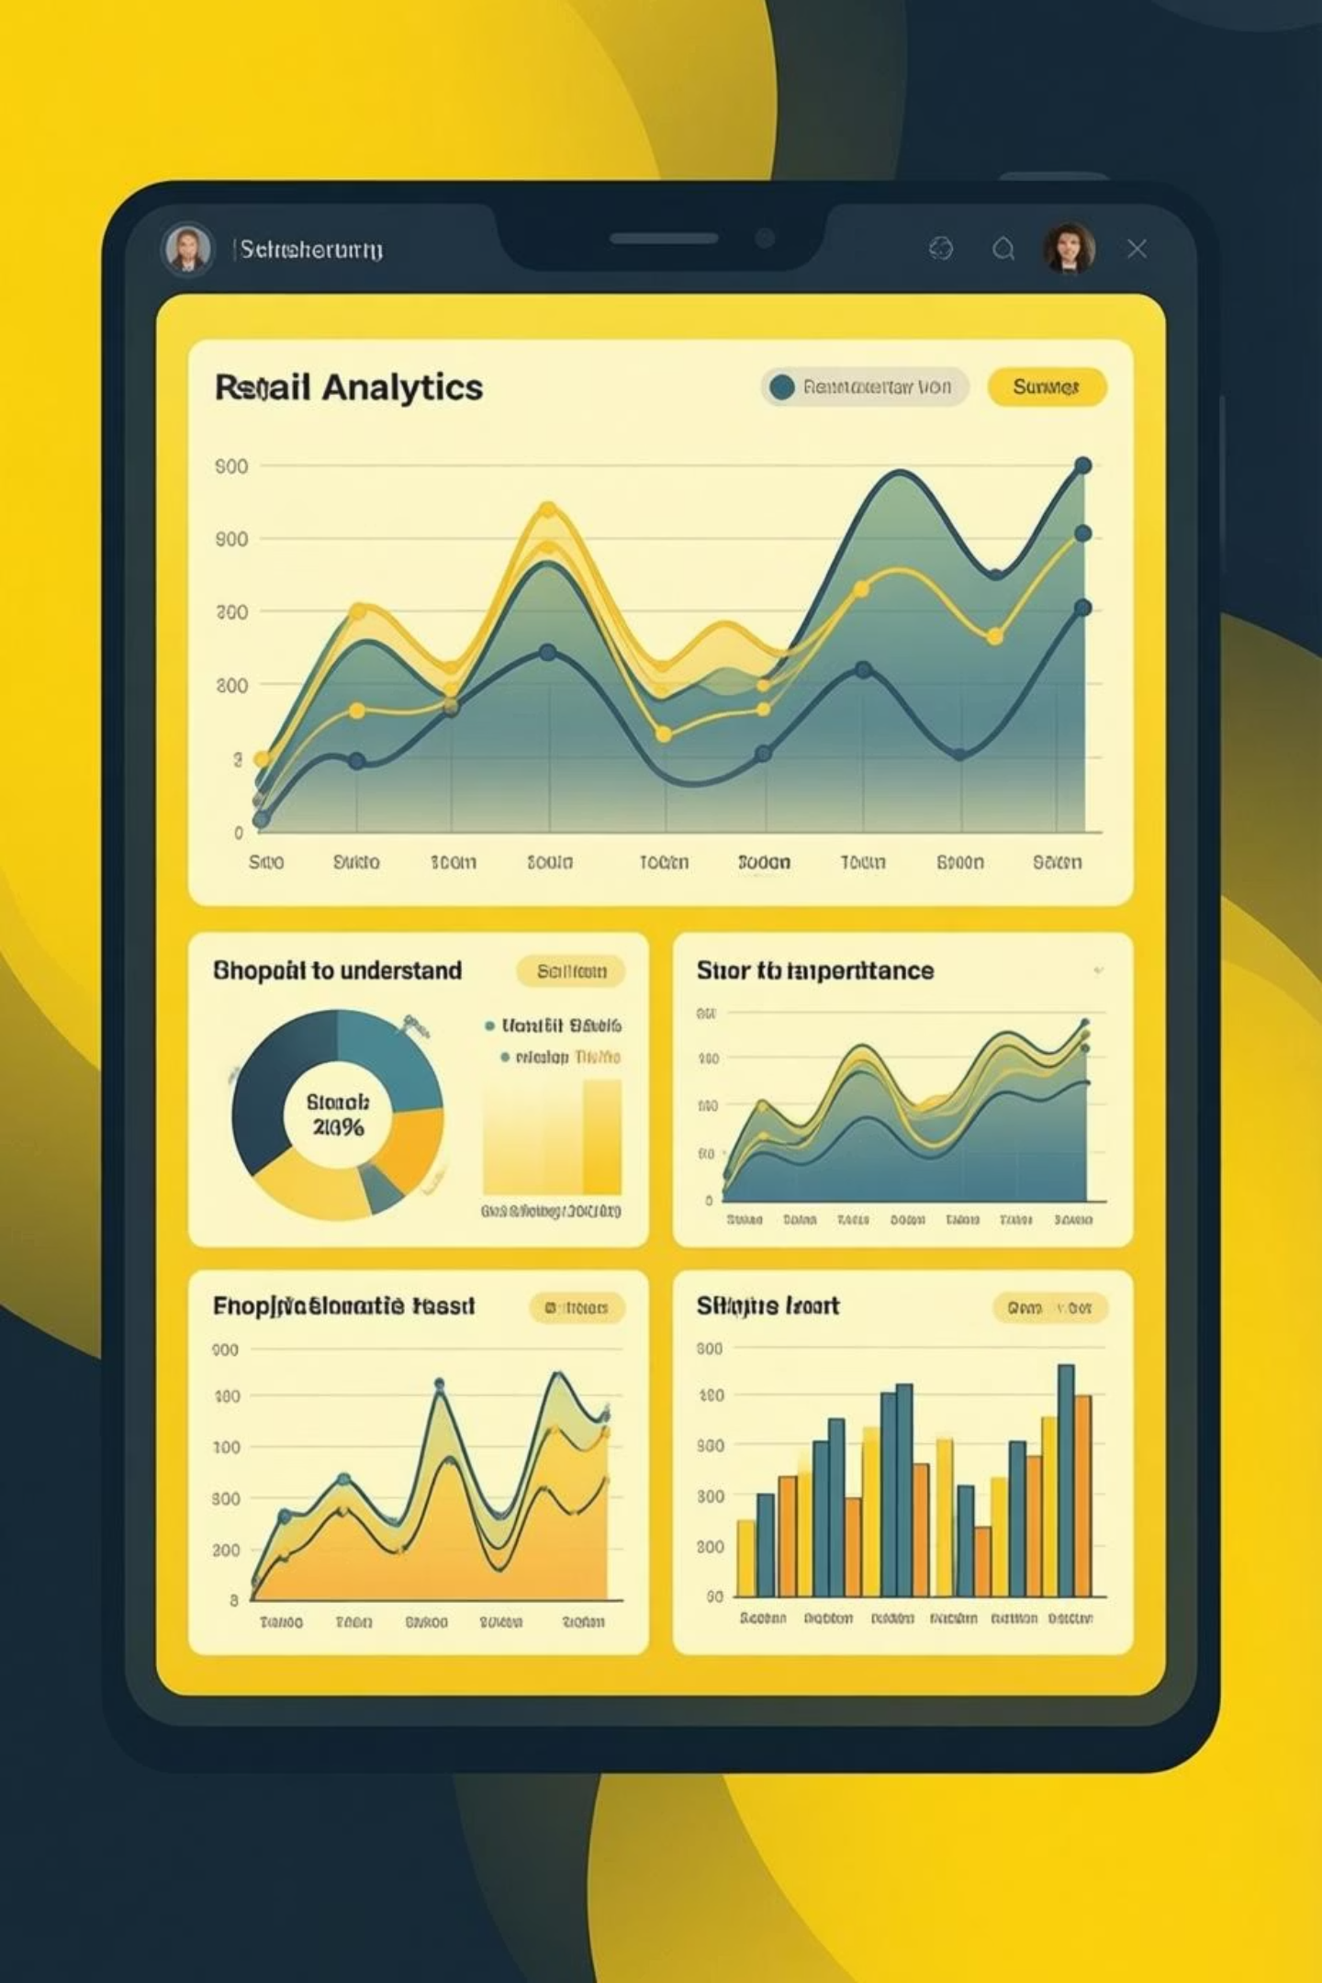
Customer Shopping Behavior Analysis
Uncovering insights from 3,900 purchases to guide strategic business decisions

Slide 2

OVERVIEW
Dataset at a Glance
3,900
18
4
Total Purchases
Data Points
Categories
Transactions analyzed
Features per transaction
Product segments
50
Locations
Geographic coverage

Slide 3


PYTHON ANALYSIS
Data Preparation & Cleaning
01
Data Loading
Imported dataset using pandas, explored structure with df.info()
02
Missing Data
Imputed 37 missing Review Ratings using category median
03
Feature Engineering
Created age_group and purchase_frequency_days columns
04
Database Integration
Connected to PostgreSQL for SQL analysis

Slide 4
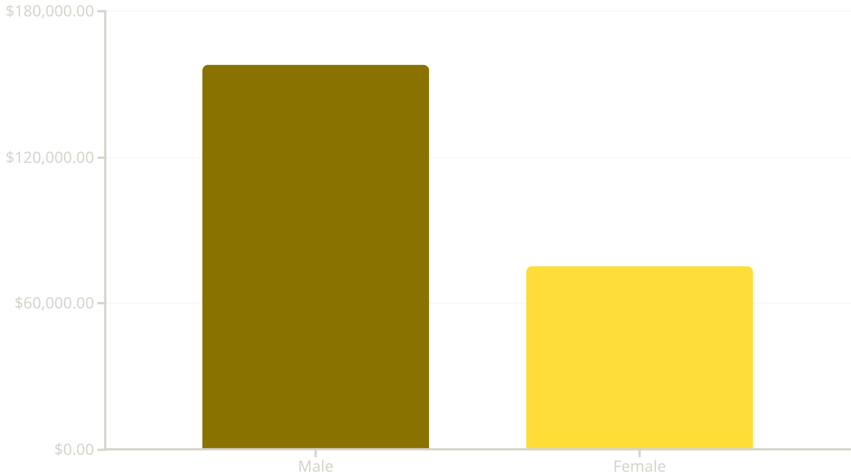
SQL INSIGHTS
Revenue by Gender
Key Finding
Male customers generate 2.1x more revenue than female customers
Total revenue: $233,081

Slide 5

High-Value Discount Users
839 Customers
Smart Shoppers
Used discounts but spent above average
Combine savings with high-value purchases
Target Segment
Prime candidates for loyalty programs

Slide 6
PRODUCT PERFORMANCE
Top-Rated Products
1
2
3
Gloves
Sandals
Boots
Rating: 3.86
Rating: 3.84
Rating: 3.82
4
5
Hat
Skirt
Rating: 3.80
Rating: 3.78
Average review rating across all products: 3.75

Slide 7



Customer Segmentation
Returning
701 customers
18% of customer base
Loyal
3,116 customers
80% of customer base
New
83 customers
2% of customer base

Slide 8
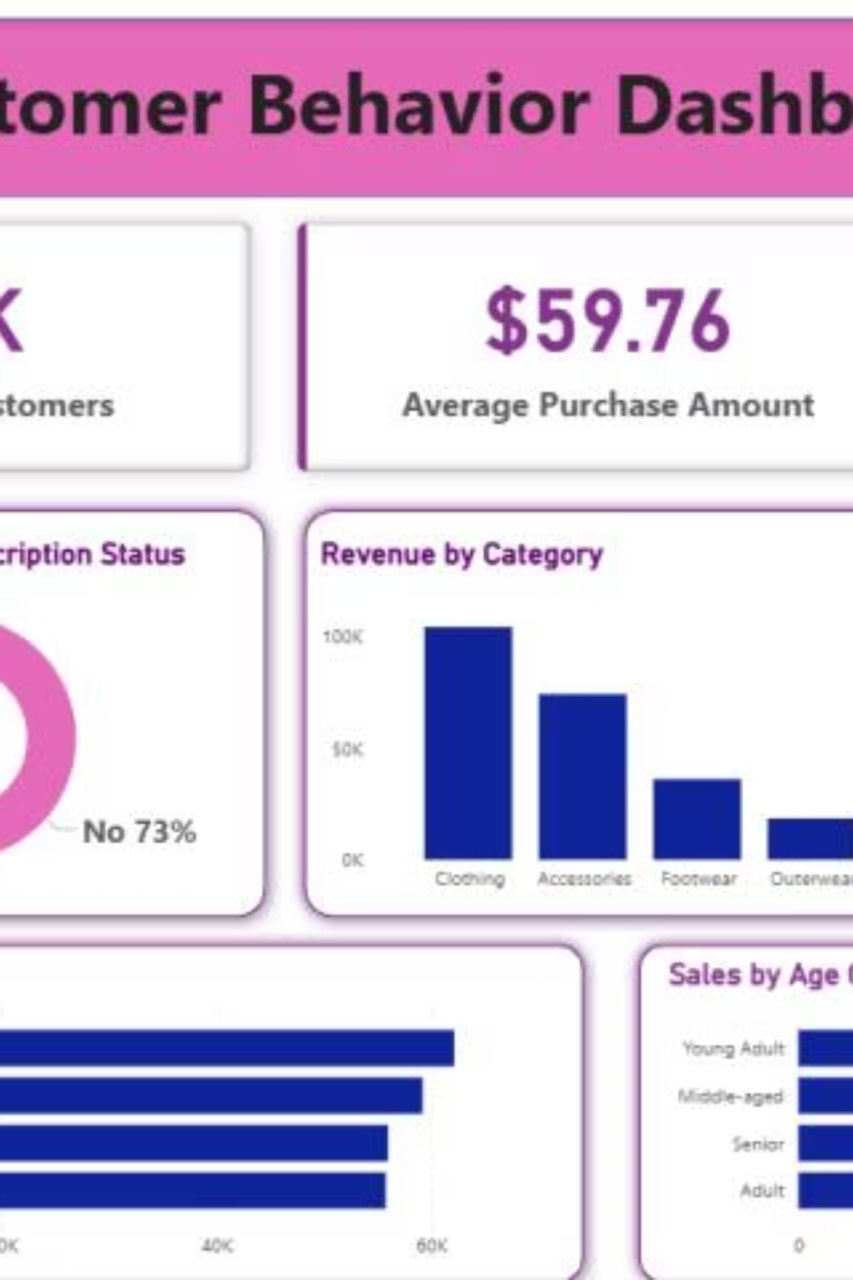
DASHBOARD
Power BI Analytics Dashboard
Interactive filters: Subscription, Gender, Category, Shipping
Visual insights: Revenue and sales by category and age group
Key metrics: 3.9K customers, $59.76 avg purchase, 3.75 avg rating

Slide 9


SUBSCRIPTION INSIGHTS
Subscribers vs. Non-Subscribers
Revenue Impact
Subscribers: $62,645 total revenue
Non-subscribers: $170,436 total revenue
27%
Average spend similar: $59.49 vs $59.87
Opportunity: Convert more customers to subscriptions
Subscribers
1,053 customers
73%
Non-Subscribers
2,847 customers

Slide 10
ACTION PLAN
Strategic Recommendations
Boost Subscriptions
Loyalty Programs
Review Discounts
Promote exclusive benefits and rewards for subscribers
Reward repeat buyers to move them into loyal segment
Balance sales boosts with margin control strategy
Targeted Marketing
Product Positioning
Focus on high-revenue age groups and express shipping users
Highlight top-rated and best-selling products in campaigns

